Slide 1
Analysis of Gun Shootings in USA 2007 to 2016
Sunitha ‘s portion - Data Bootcamp |
2018

Slide 2
Story
With the recent mass shootings that have been happening all across the country, especially in schools and the most recent one on Feb 14th at Parkland School in FL, I was really touched and wanted to find the epidemic created by these senseless mass shootings
That prompted me to choose this topic for analysis
I have watched 60 minutes on CBS show and the march that took place on March 24th across the nation
Question:
I wanted to understand the magnitude of shootings and the resulting deaths by county
Following charts will demonstrate the results of this analysis

Slide 3


Slide 4
Challenges of collecting geolocate (latitude & longitude) to given an county address
Could not get for free, the latitude and longitude coordinates with https://carto.com/location-data-services/geocoding/ given a city name.
Used Google Maps API to geolocate a query to an address and coordinates: https://developers.google.com/maps/
Also tried with geopy which is a Python 2 and 3 client for several popular geocoding web services. https://pypi.python.org/pypi/geopy#downloads

Slide 5
Challenges of collecting Population to Every County in a State
United States Census Bureau https://www.census.gov/quickfacts/fact/table/US/PST045217
https://en.wikipedia.org/wiki/List_of_counties_in_California
https://www.census.gov/data/datasets/2016/demo/popest/counties-detail.html
https://factfinder.census.gov/faces/tableservices/jsf/pages/productview.xhtml?src=bkmk
US Census API– don’t have all the data only with some of the years, county & state FIPS
https://api.census.gov/data/2010/sf1?key=6756f7325cf88843d478018eb4f3e62e87d767c4&get=P0010001&in=state:006&for=county:001
https://stackoverflow.com/questions/28933220/us-census-api-get-the-population-of-every-city-in-a-state-using-python

Slide 6
Visualization of Gun Shootings and Death Toll in the United States of America!
Notes:
It’s important to keep in mind why you joined this class. Let’s talk about your goals.

Slide 7
Number of Deaths by County in the USA without normalization
Cluster Circle Markers Visualization – Represents the number of deaths in each county
Size of the radius represents the total number of deaths for that County
// Define a markerSize function that will give each county a different radius based on its deaths function markerSize(deaths) {return deaths * 1000;} <= This will make the marker’s size proportionate to its death counts
radius: markerSize(deaths) <= This determines the Radius of the Circle
Interactive map of the US with numbers of deaths , setting the circles radius equal to the output of the markerSize function.

Slide 8
Actual Deaths Data Table
Deaths <100
County Name, State | # of Deaths
Contra Costa County, CA | 96
Sacramento County, CA | 95
Hamilton County, OH | 87
Oklahoma County, OK | 66
San Joaquin County, CA | 66
San Diego County, CA | 63
Fresno County, CA | 48
Kern County, CA | 41
Erie County, NY | 37
Mecklenburg County, NC | 36
Davidson County, TN | 34
Genesee County, MI | 33
Fairfield County, CT | 28
Hillsborough County, FL | 24
Suffolk County, MA | 24
King County, WA | 23
Orange County, CA | 23
Pima County, AZ | 22
Montgomery County, OH | 21
Tulsa County, OK | 20
San Francisco County, CA | 14
Baltimore County, MD | 12
Mobile County, AL | 12
Pulaski County, AR | 12
Broome County, NY | 11
Camden County, NJ | 11
Douglas County, NE | 11
El Paso County, CO | 11
Osceola County, FL | 11
Summit County, OH | 11
Allen County, IN | 10
Bernalillo County, NM | 10
Monterey County, CA | 10
Montgomery County, VA | 10
New Castle County, DE | 10
Queens County, NY | 10
Wyandotte County, KS | 10
Deaths >100 & <1000
County Name, State | # of Deaths
Kings County, NY | 898
Marion County, IN | 663
Alameda County, CA | 591
St. Louis city, MO | 506
Fulton County, GA | 486
Duval County, FL | 476
Essex County, NJ | 459
Clark County, NV | 444
Bexar County, TX | 435
San Bernardino County, CA | 429
Cuyahoga County, OH | 428
Jackson County, MO | 427
Jefferson County, AL | 414
District of Columbia, DC | 396
Milwaukee County, WI | 379
Franklin County, OH | 277
Allegheny County, PA | 273
Prince George's County, MD | 268
St. Louis County, MO | 247
Tarrant County, TX | 184
DeKalb County, GA | 183
Bronx County, NY | 180
Riverside County, CA | 177
East Baton Rouge Parish, LA | 173
Orange County, FL | 160
Palm Beach County, FL | 151
Broward County, FL | 139
Lake County, IN | 113
Jefferson County, KY | 110
Jefferson Parish, LA | 101
Deaths >1000
County Name, State | # of Deaths
Los Angeles County, CA | 5252
Cook County, IL | 5113
Wayne County, MI | 3044
Harris County, TX | 2984
Philadelphia County, PA | 2588
Maricopa County, AZ | 1851
Miami-Dade County, FL | 1845
Baltimore city, MD | 1743
Dallas County, TX | 1389
Orleans Parish, LA | 1241
Shelby County, TN | 1117

Slide 9
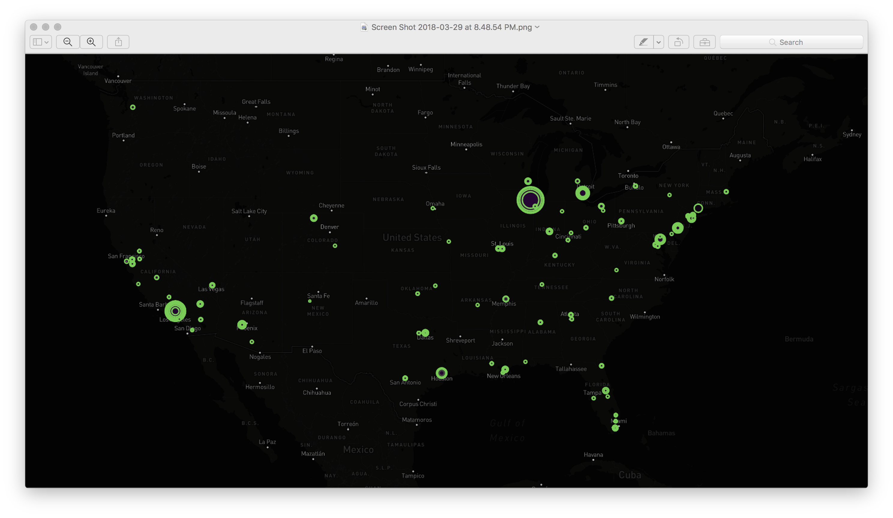
Map of Death toll by County in USA without normalization

Slide 10
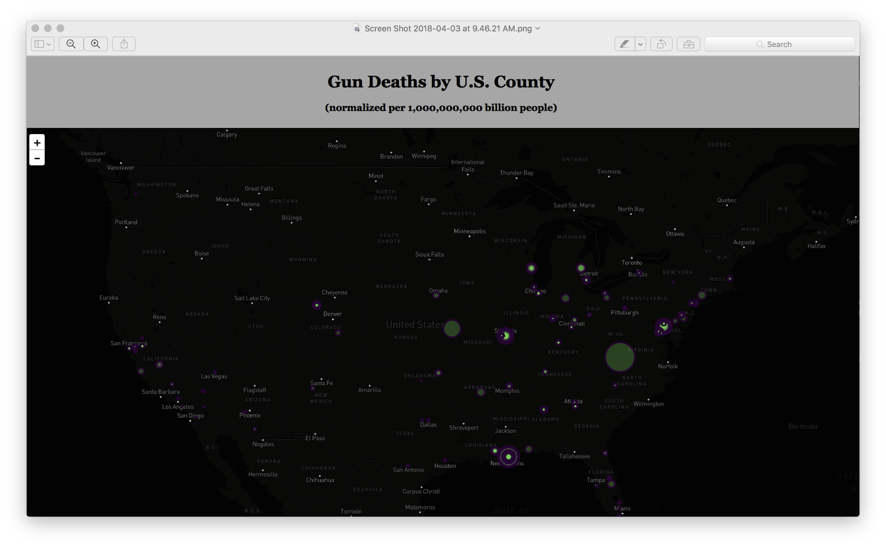

Slide 11
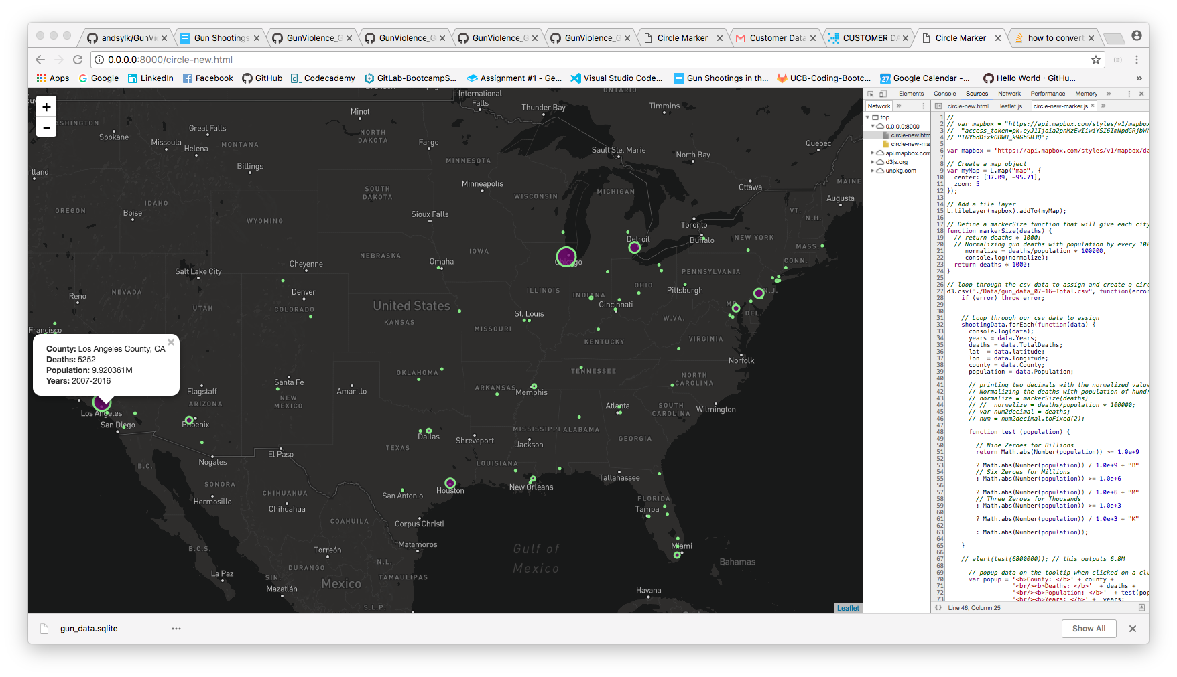
Counties with the highest number of deaths cause by gun violence

Slide 12
Count of Mass shootings by County in USA
Cluster Markers Visualization – Represents the number of Mass shootings in a given county
Interactive map of the US – Provides
Month/Year of the shootings
Number of Deaths
County Names
User can zoom in for granular info for time based data for a given county

Slide 13
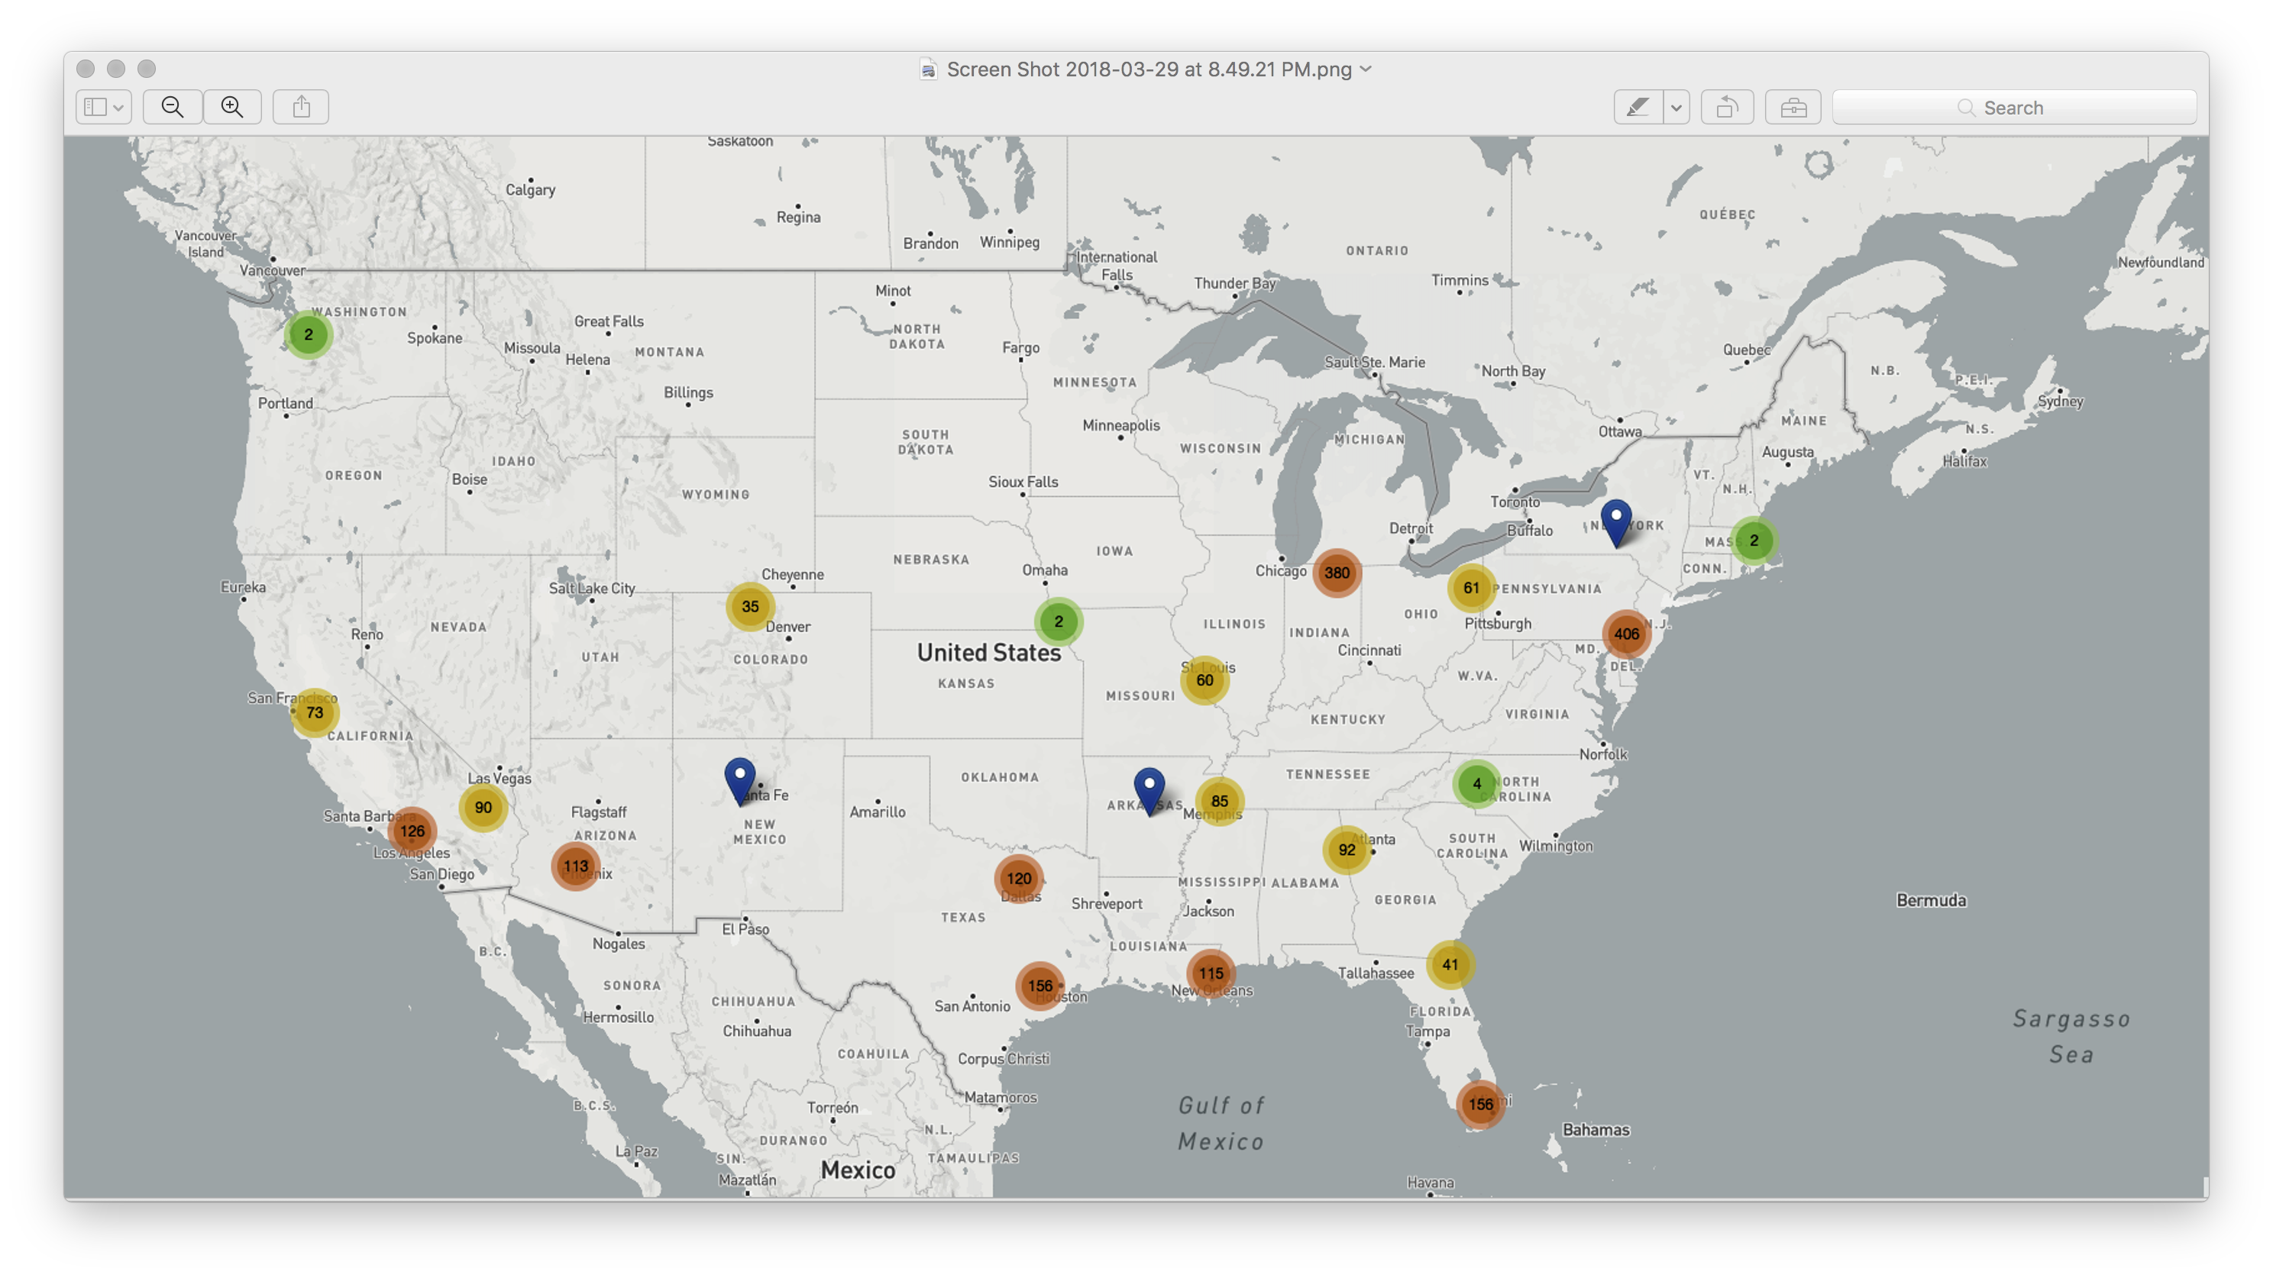
Count of Mass shootings by County in USA

Slide 14
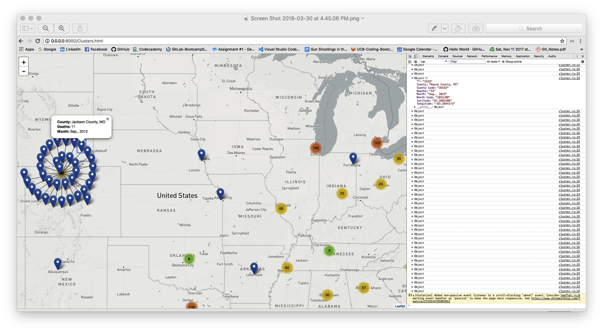
Challenge: Mass shooting by same county had this ripple snail effect -
As every same county has the same geolocation, with different dates/timeframe.

Slide 15
Questions / Discussion
Notes:
It’s important to keep in mind why you joined this class. Let’s talk about your goals.

